Slide 1



BITS Solutions Ltd. has built its success around the development of customized
business solutions and recognized as expert in strategic global models to deliver ICT products including ERP business solutions of the highest quality both in domestic and international arena.
REF-07
PROPOSED SOLUTION
Notes:
To view this presentation, first, turn up your volume and second, launch the self-running slide show.

Slide 2
Presentation By
Alim Ul Karim
Notes:
To view this presentation, first, turn up your volume and second, launch the self-running slide show.

Slide 3

ToolBox
php
silverlight
mysql
asp
Oracle
.net
LightSwitch
Microsoft SQL Server 2008 R2
java
LINQ
Microsoft Access
flex
WCF
WPF
Service Structure
Ruby on Rails
2-tier
3-tier
Notes:
You are not giving your presentation to have another meeting. You are there to covey meaning.

Slide 4
Solution Architecture
We like to think of it as a toolbox , where different tools are fit for the right job.
Notes:
You are not giving your presentation to have another meeting. You are there to covey meaning.

Slide 5
Solution Architecture
Many choices? But, it is
Critical
Important
Final
to choose the right one?
Notes:
You are not giving your presentation to have another meeting. You are there to covey meaning.

Slide 6
Solution Architecture
Simplification of requirements describe what tools we need for our job.
Notes:
You are not giving your presentation to have another meeting. You are there to covey meaning.

Slide 7
Solution Architecture
Requirements:
Web-based Application
Offline Support: Desktop Software
Multiuser Support
Synchronization Ability
Zero Data Loss.
Modules: Accounting & Inventory
Integration with Existing MIS
Simple, isn’t it?
Notes:
You are not giving your presentation to have another meeting. You are there to covey meaning.

Slide 8
Solution Architecture
+ Requirements:
Deploy in short time
Security Issue / User Previleges
Flexible Changing Capability
3-Tier System
Data Validation
Notes:
You are not giving your presentation to have another meeting. You are there to covey meaning.

Slide 9
3-Tier Architecture
3-tier Architecture system is way of communicating with server by 3 different steps. Where the database is very safe and protected from outside the world.
So lets learn more about it.
Notes:
You are not giving your presentation to have another meeting. You are there to covey meaning.

Slide 10




3-Tier Architecture
Presentation Layer
Business Logic
Data Layer
Software
browser
WebSite
OS: Linux/Windows Server…
Server: Apache/IIS Web Server…
PHP/.NET Framework/JDK…
SQL Server / Oracle/MySQL
Client Tier/Client Machine
Middle Tier/Application Server
Database Tier/Database Server
Client Tier : Operating System (Windows 95/98, Linux)
Web browser : (Internet Explorer 9.0/Google Chrome)
Components : Flash/.NET/JRE/SilverLight….
Database Tier: MySQL Server/ SQL Server/Oracle etc….
Middle Tier: Linux/Windows operating system
Apache/IIS Web Server
Scripting Engine PHP,ASP etc…
Notes:
You are not giving your presentation to have another meeting. You are there to covey meaning.

Slide 11
Solution Architecture
Combine all pros and cons
Microsoft LightSwitch 2011
is the best tool for this purpose.
Notes:
You are not giving your presentation to have another meeting. You are there to covey meaning.

Slide 12
Solution Architecture
Why?
Microsoft LightSwitch 2011
is the best tool for this purpose.
Notes:
You are not giving your presentation to have another meeting. You are there to covey meaning.

Slide 13
LightSwitch 2011
Reasons Behind Choosing LightSwitch:
LightSwitch was developed with all new and proven technologies like Silverlight , WCF, Data Layers , Entity Models etc…
Pagination Solution for every Data Layer.
Deployed applications are similar like Microsoft Office with Rich User Interface.
Data Validation
Multilevel Protection
Security
Above all it supports both Software and Web-based Application from one development environment. Which makes it perfect for this job. It will reduce the development time with maximum productivity.
In addition, it also supports 3-tier system deployment.
Notes:
You are not giving your presentation to have another meeting. You are there to covey meaning.

Slide 14
Solution Architecture
Solution Architecture?
Notes:
You are not giving your presentation to have another meeting. You are there to covey meaning.

Slide 15
Solution Architecture
Presentation Layer
Business Logic
Data Layer
Backup Server
Software
browser
WebSite
OS: Windows Server 7/ 2008 Server…
Server: IIS 7Web Server…
.NET Framework + SilverLight Components
SQL Server 2008 R2
Client Tier/Client Machine
Middle Tier/Application Server
Database Tier/Database Server
Client Tier : Operating System (Windows 95/98, Linux)
Web browser : (Internet Explorer 9.0/Google Chrome)
Components : Flash/.NET/JRE/SilverLight….
Database Tier: SQL Server 2008 R2
Middle Tier: Windows Based OS
IIS 7.0 Web Server
.NET Framework 4.0 + all needed components
Notes:
You are not giving your presentation to have another meeting. You are there to covey meaning.

Slide 16
Solution Architecture
Our solution architecture must have Windows Based Database and Application Server with SQL Server 2008 R2.
For online entry, client machine could be any OS but for offline entry mode client machine must be Windows 7 or latter.
For offline based entry , client machines needs to be connected with client server.
Synchronizing Software will synchronize the client server data to the main server.
Notes:
You are not giving your presentation to have another meeting. You are there to covey meaning.

Slide 17
Solution Architecture
Why Windows not Linux?
Although Windows is not free but it is much more productive and effective in business world.
How come?
Server machines have multiple core processors with high performance threading capability and compare to any other operating systems in the business world, Windows have the best proficiency.
Hence that there should be no doubt to choose Windows as Server than Linux as free Operating System.
Notes:
You are not giving your presentation to have another meeting. You are there to covey meaning.

Slide 18
Solution Architecture
Protection for Zero Data Loss
SQL Server 2008 R2
Client SQL Server 2008 R2
Synchronizing Software
browser
Running Web-based Application
Offline Software Application
New Entry + Edit
Only new entries possible
Notes:
You are not giving your presentation to have another meeting. You are there to covey meaning.

Slide 19
Applications and Services
Services:
One or two Web-based Solution with Accounting and Inventory Module.
One or two Desktop Application same as web-based solution.
Reporting service online.
Reporting service offline.
Synchronizing Software to Synchronize Data as a Pack , so there should be no data loss.
Every editing should be saved as ledger , so if there any data misplaced in the system, admin can restore it.
Every clinic and NGO will have a small client server where small limited service software should be installed based on the need.
Notes:
You are not giving your presentation to have another meeting. You are there to covey meaning.

Slide 20
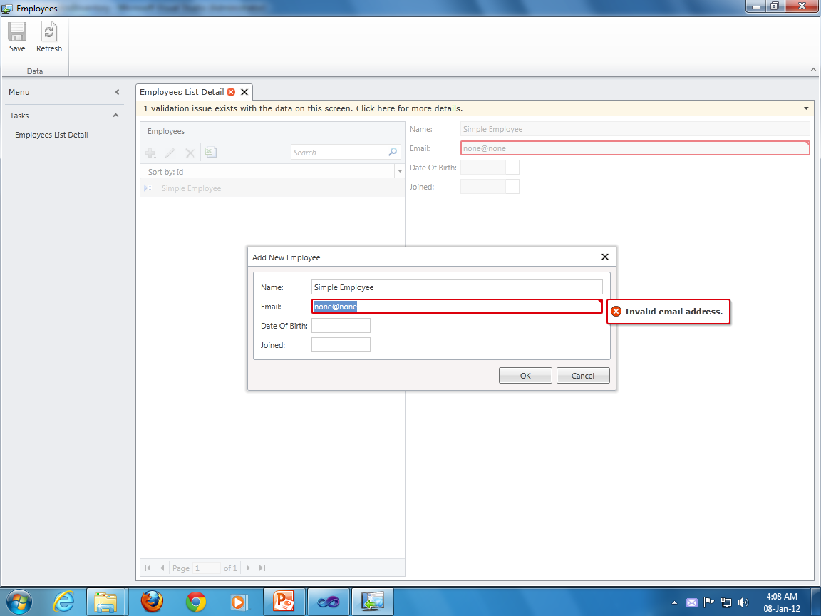
LightSwitch Screenshots
Validation Examples
Notes:
You are not giving your presentation to have another meeting. You are there to covey meaning.

Slide 21
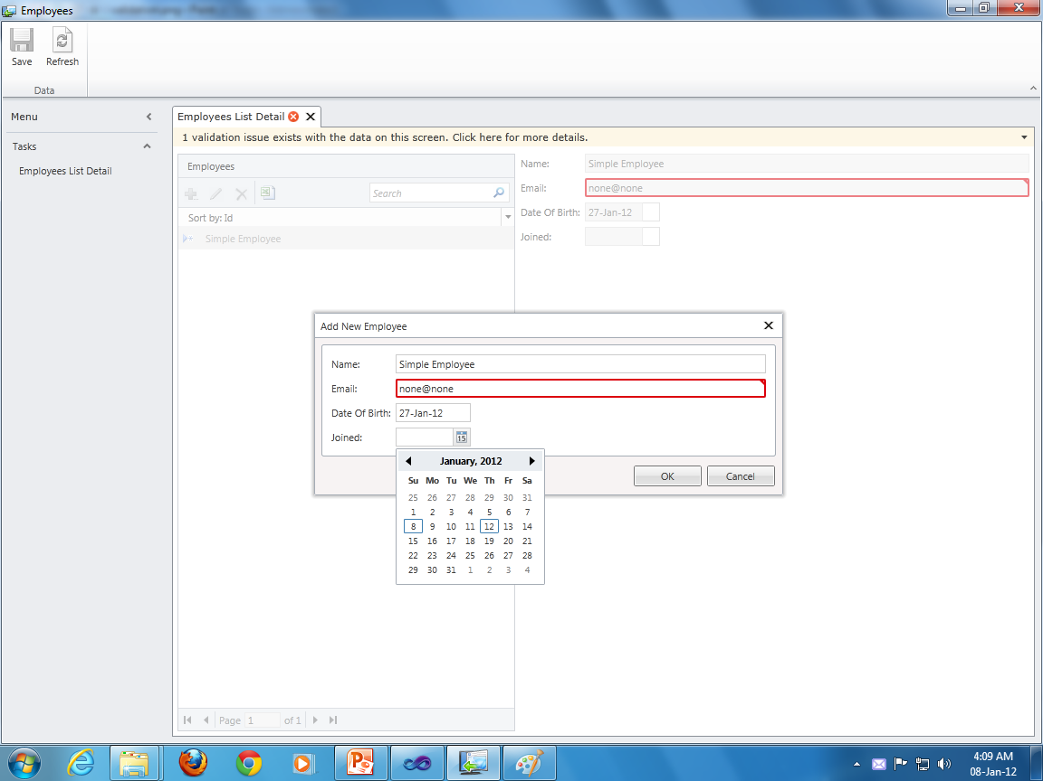
LightSwitch Screenshots
Rich Components Examples
Notes:
You are not giving your presentation to have another meeting. You are there to covey meaning.

Slide 22
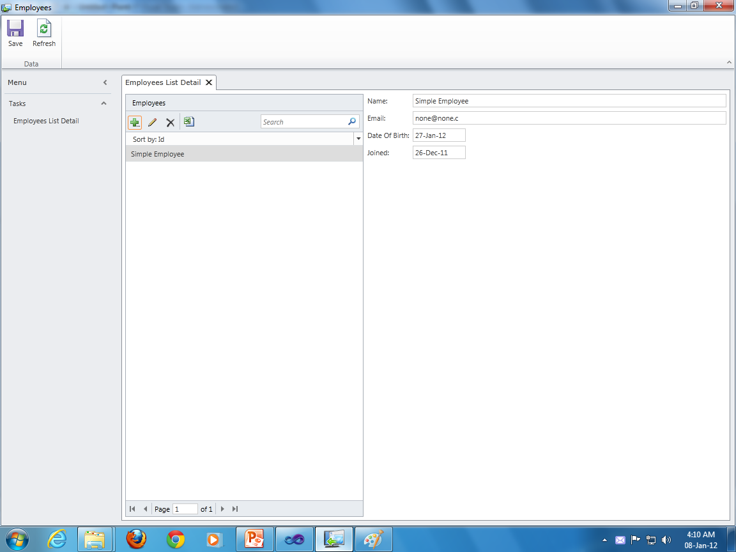
LightSwitch Screenshots
Excel Reports on the Fly
List of modules and its tasks
User Interface Like MS Office
Pagination
Notes:
You are not giving your presentation to have another meeting. You are there to covey meaning.

Slide 23
Hardware Requirements
Database Server
Application Server
Backup Server
Client Machine
Xenon Dual
Processor Quad
Core, 16 GB RAM
2TB HDD
SQL Server
Xenon Dual
Processor Quad
Core 2.0, L3 15 MB Cache
16 GB RAM
2TB HDD
ATI 5570 HD GPU
Core I3, 8 GB RAM
4TB HDD
Dual Core 2.0,
1GB Ram
ATI 4600 HD GPU
Client Server
Core I3 2.0,
1GB Ram
1TB HDD
Notes:
You are not giving your presentation to have another meeting. You are there to covey meaning.

Slide 24
Solution
Thank you
for watching our demo.
Notes:
You are not giving your presentation to have another meeting. You are there to covey meaning.

Slide 25
Solution
End
Notes:
You are not giving your presentation to have another meeting. You are there to covey meaning.

